Slide 1
Restconf

Slide 2

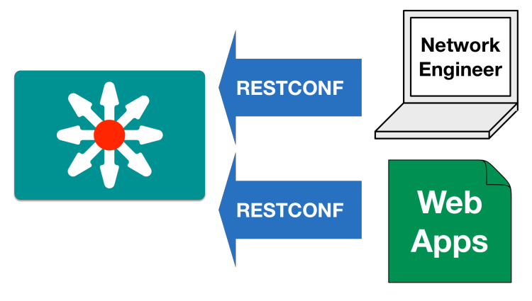
Why Restconf?
Network Management Protocols are used to communicate between a network automation client to a network device. There are various options like CLI, SNMP, Netconf and Restconf
The command-line interface is excellent for us humans, but it can be a pain for computers/automation. When we use commands, we see the results and interpret what must happen next, but network automation devices don’t have this intuitive capability. That’s why we need predefined data formats and structures for automation devices to interface correctly with the CLI.
SNMP was developed to standardize network device management. SNMP works “reasonably well for device monitoring” and it is not used for configuration
Lack of Writeable MIBs
Security Concerns
Difficult to Replay/Rollback
NETCONF protocol provides mechanisms to install, manipulate, and delete the configuration
of network devices. It is based on XML messages exchanged via SSH protocol.
There is need of Netconf client to interact with network devices. Network admin has to
Learn netconf protocol to automate the device configurations.
RESTCONF protocol was introduced as a simpler alternative to the original NETCONF protocol.
There is a need for standard mechanisms to allow Web applications to access the
configuration data, state data, data-model-specific Remote Procedure Call (RPC) operations,
and event notifications within a networking device, in a modular and extensible manner.
RESTCONF runs over HTTPS (port 443)
it uses HTTP-based REST APIs, which are currently the most popular protocols used
in the automation.
It provides the familiar HTTP methods when exchanging data: GET, POST, PATCH, PUT,
DELETE.
Notes:
Add points
Remove NMS

Slide 3
RESTCONF Details
Uses Https for transport
Tightly coupled to the YANG data model definitions
It uses Http methods to provide CRUD operations on a datastore containing YANG-defined data
Configuration data and state data are exposed as resources that can be retrieved with the GET method.
Resources representing configuration data can be modified with the DELETE, PATCH, POST, and PUT methods.
Data is encoded with either XML/JSON
Data-model-specific RPC operations defined with the YANG "rpc" or "action" statements can be invoked with the POST method.
Data-model-specific event notifications defined with the YANG "notification" statement can be accessed.
“An HTTP-based protocol that provides a programmatic interface for accessing data defined in YANG”
https://tools.ietf.org/html/rfc8040

Slide 4
RESTCONF versus NETCONF
 | NETCONF(RFC 6241) | RESTCONF(RFC 8040)
Transmission Channel(protocol) | It uses SSH to transmit messages | It is based on HTTP
Data format | Supports only XML | Supports XML or JSON
Data modelling Language | YANG? YANG models define the schema for network configuration, hence migrating to NETCONF/YANG enables carriers to standardise their schemas. As YANG models are standardised in the IETF the schemas then will be standardised across vendors, and across carriers. | Same as netconf, supports YANG modelling language
DataStores | Supports multiple configuration datastores, candidate (working copy to manipulate with no impact on the current configuration, for prevalidate), running (complete and active configuration), startup (configuration loaded by the device at startup). | Supports single “unified” datastore that behaves mostly like the running datastore in NETCONF
Configuration Rollback | Supported | Not supported
Validation | Supports two-phase configuration. Parameters are configured and committed before taking effect | Operations take effect immediately
Stateless | Session-oriented and stateful | Stateless, The server will keep an active session open with the client
Netconf client tool | Netconf client tool is required | Any web application can communicate with RESTCONF server.
locks | Supported | Not supported
Network-wide transactions | Supported | Not supported

Slide 5
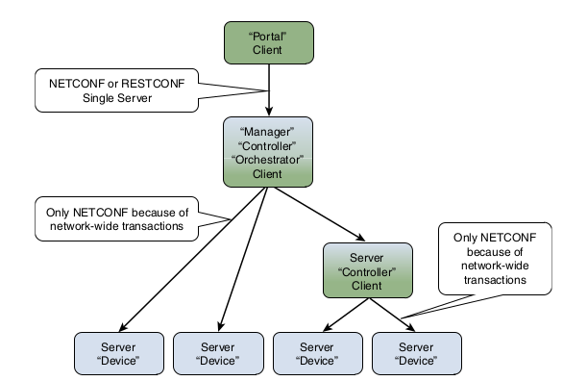
Different usecases where NETCONF & RESTCONF are suitable
NETCONF is based on clients establishing a session to the server, and that is certainly not stateless. In NETCONF, clients often connect and then manipulate the candidate datastore with a number of edit-config operations. At a certain time, the client may issue a validation call. If that succeeds on all servers, a commit operation may follow.
RESTCONF follows the REST principles. It means that in RESTCONF, any request the client wants to send needs to be sent in its entirety and acted upon by the server immediately. No transactions that span multiple messages are possible.
network-wide transactions, are not possible in RESTCONF but supported by NETCONF.
In practical terms, this means that RESTCONF is useful when the client needs to manage a single system. This is often the case for web portals or applications running on top of a controller or orchestrator.
NETCONF is much better suited when the client needs to manage multiple systems. This is often the case for the controller/orchestrator itself. Servers that participate in scenarios where they are managed by a controller/orchestrator need to support NETCONF.
Notes:
Make points

Slide 6
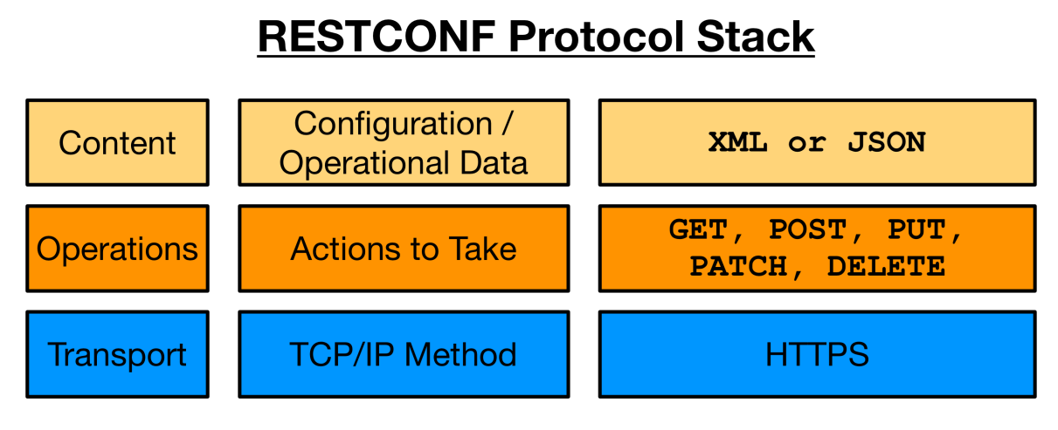
RESTCONF Protocol stack & Transport

Slide 7
CRUD Methods in RESTCONF
RESTCONF | NETCONF
OPTIONS | none
HEAD | <get-config>, <get>
GET | <get-config>, <get>
POST | <edit-config> (nc:operation="create")
POST | Invoke an RPC Operation
PUT | <edit-config> (nc:operation="create/replace")
PATCH | <edit-config> (operation="merge")
DELETE | <edit-config> (nc:operation="delete")
Notes:
OPtions/head details

Slide 8
Finding the RESTCONF Server URI
In order to find out the root URL is for the RESTCONF subsystem, a client should run a GET toward the /.well-known/host-meta URL. This should return a list of links to various services available on this HTTP server. If indeed this is a RESTCONF server, one of the links will have an attribute rel='restconf' and another attribute, href= , that points out the root URL to use to speak to the RESTCONF server.
Example:
The client might send the following:
GET /.well-known/host-meta HTTP/1.1
Host: example.com
Accept: application/xrd+xml
The server might respond as follows:
HTTP/1.1 200 OK
Content-Type: application/xrd+xml
Content-Length: nnn
<XRD xmlns=’http://docs.oasis-open.org/ns/xri/xrd-1.0’>
<Link rel=’restconf’ href=’/restconf’/>
</XRD>
After discovering the RESTCONF API root, the client MUST use this value as the initial part of the path in the request URI, in any subsequent request for a RESTCONF resource.

Slide 9
Reading and Navigating the RESTCONF Resources
GET Request for the restconf Root resource
GET /restconf HTTP/1.1
Host: localhost:8080
GET Reply for the restconf Root resource
Server:
Date: Thu, 04 Jan 2018 13:22:18 GMT
Cache-Control: private, no-cache, must-revalidate, proxy-revalidate
Content-Length: 157
Content-Type: application/yang-data+xml
Vary: Accept-Encoding
Pragma: no-cache
<restconf xmlns="urn:ietf:params:xml:ns:yang:ietf-restconf">
<data/>
<operations/>
<yang-library-version>2016-06-21</yang-library-version>
</restconf>
data : Represents datastore resources, which is collection of configuration and state data nodes
operations: Provides access to the data-model-specific RPC operations supported by the server
yang-library: Identifies the revision date of the “ietf-yang-library” YANG module that is implemented by this server

Slide 10
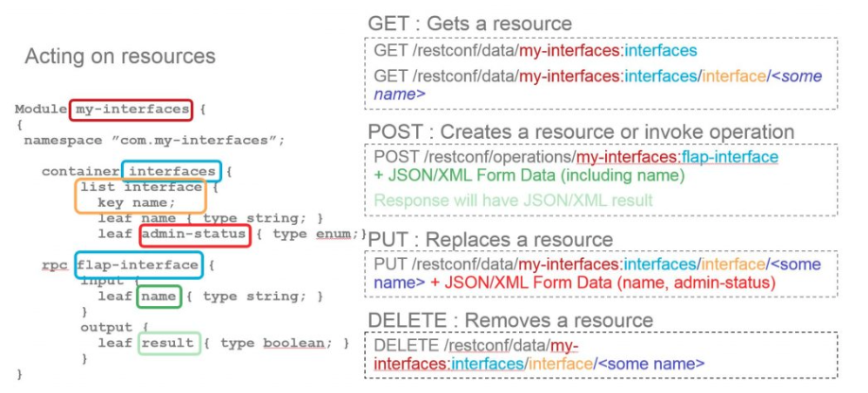
Constructing RESTCONF URIs for Data Resources
https://<address>/<root>/data/<yang-module>:<datanode>/<datanode>[?<options>]
Address - Of the Restconf server
Root - The main entry point for Restconf requests. Discoverable at https://<address>/.well-known/host-meta
Data - The Restconf API resource type for data
yang-module:datanode - The base model container being used. Providing the module name is optional
The operations resource type used to access RPC operations available
datanode - An individual element from within the container
[?<options>]- optional parameters that impact returned results
A RESTCONF data resource identifier is encoded from left to right, starting with the top-level data node. The node name of each ancestor of the target resource node is encoded in order, ending with the node name for the target resource. If a node in the path is defined in a module other than its parent node or its parent is the datastore, then the module name followed by a colon character (":") MUST be prepended to the node name in the resource identifier.
URL creation example

Slide 11
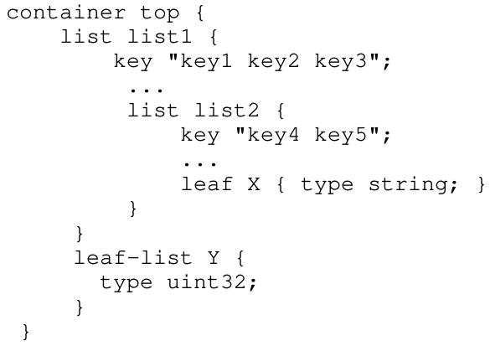
Constructing URI for list-instance
If there is only one key leaf value, the path segment is constructed by having the list name, followed by an "=" character, followed by the single key leaf value
If there are multiple key leaf values, the path segment is constructed by having the list name, followed by the value of each leaf identified in the "key" statement, encoded in the order specified in the YANG "key" statement. Each key leaf value except the last one is followed by a comma character.
Missing key values are not allowed, so two consecutive commas are interpreted as a comma, followed by a zero-length string, followed by a comma. For example, "list1=foo,,baz" would be interpreted as a list named "list1" with three key values, and the second key value is a zero-length string
Note that non-configuration lists are not required to define keys. In this case, a single list instance cannot be accessed
For the above YANG definition, the container "top" is defined in the "example-top" YANG module, and a target resource URI for leaf "X"
would be encoded as follows:
/restconf/data/example-top:top/list1=key1,key2,key3/list2=key4,key5/X
For the above YANG definition, a target resource URI for
leaf-list "Y" would be encoded as follows:
/restconf/data/example-top:top/Y=instance-value
list-instance = api-identifier "=" key-value *("," key-value)
key-value = string
ABNF grammar for list instance

Slide 12
GET - Operation
The GET method is sent by the client to retrieve data resource.
GET /restconf/data/example-jukebox:jukebox/library/artist=Foo%20Fighters/album=Wasting%20Light HTTP/1.1
Host: example.com
Accept: application/yang-data+xml
The server might respond as follows:
HTTP/1.1 200 OK
Date: Thu, 26 Jan 2017 20:56:30 GMT
Server: example-server
Content-Type: application/yang-data+xml
Cache-Control: no-cache
ETag: "a74eefc993a2b"
Last-Modified: Thu, 26 Jan 2017 14:02:14 GMT
<album xmlns="http://example.com/ns/example-jukebox"
xmlns:jbox="http://example.com/ns/example-jukebox">
<name>Wasting Light</name>
<genre>jbox:alternative</genre>
<year>2011</year>
</album>

Slide 13
POST Operation
The POST method is sent by the client to create new data resource
To create a new "artist" resource within the "library" resource, the client might send the following request:
POST /restconf/data/example-jukebox:jukebox/library
Host: example.com
Content-Type: application/yang-data+json
{
"example-jukebox:artist":[
{
"name":"Foo Fighters"
}
]
}
If the resource is created, the server might respond as follows:
HTTP/1.1 201 Created
Date: Thu, 26 Jan 2017 20:56:30 GMT
Server: example-server
Location: https://example.com/restconf/data/\
example-jukebox:jukebox/library/artist=Foo%20Fighters
Last-Modified: Thu, 26 Jan 2017 20:56:30 GMT
ETag: "b3830f23a4c"

Slide 14
PUT
To replace the "album" resource contents, the client might send the following:
PUT /restconf/data/example-jukebox:jukebox/library/artist=Foo%20Fighters/album=Wasting%20Light
Host: example.com
Content-Type: application/yang-data+json
{
"example-jukebox:album":[
{
"name":"Wasting Light",
"genre":"example-jukebox:alternative",
"year":2011
}
]
}
If the resource is updated, the server might respond as follows:
HTTP/1.1 204 No Content
Date: Thu, 26 Jan 2017 20:56:30 GMT
Server: example-server
Last-Modified: Thu, 26 Jan 2017 20:56:30 GMT
ETag: "b27480aeda4c"
The PUT method is sent by the client to create or replace the target data resource.
A request message-body MUST be present, representing the new data resource.
Both the POST and PUT methods can be used to create data resources. The difference is that for POST, the client does not provide the resource identifier for the resource that will be created. The target resource for the POST method for resource creation is the parent of the new resource. The target resource for the PUT method for resource creation is the new resource.

Slide 15
DELETE Operation
The DELETE method is used to delete the target resource.
Example:
To delete the "album" resource with the key "Wasting Light", the
client might send the following:
DELETE /restconf/data/example-jukebox:jukebox/\
library/artist=Foo%20Fighters/album=Wasting%20Light HTTP/1.1
Host: example.com
If the resource is deleted, the server might respond as follows:
HTTP/1.1 204 No Content
Date: Thu, 26 Jan 2017 20:56:30 GMT
Server: example-server

Slide 16
Plain Patch Operation
Example:
To replace just the "year" field in the "album" resource (instead of replacing the entire resource with the PUT method), the client might send a plain patch as follows:
PATCH /restconf/data/example-jukebox:jukebox/library/artist=Foo%20Fighters/album=Wasting%20Light HTTP/1.1
Host: example.com
If-Match: "b8389233a4c"
Content-Type: application/yang-data+xml
<album xmlns="http://example.com/ns/example-jukebox">
<year>2011</year>
</album>
If the field is updated, the server might respond as follows:
HTTP/1.1 204 No Content
Date: Thu, 26 Jan 2017 20:56:30 GMT
Server: example-server
Last-Modified: Thu, 26 Jan 2017 20:56:30 GMT
ETag: "b2788923da4c"
The plain patch mechanism merges the contents of the message-body with the target resource.
Plain patch can be used to create, or update, but not delete, a child resource within the target resource.
If the target resource represents a YANG leaf-list, then the PATCH method MUST NOT change the value of the leaf-list instance.
If the target resource represents a YANG list instance, then the key leaf values, in message-body representation, MUST be the same as the key leaf values in the request URI

Slide 17
YANG Patch
PATCH /restconf/data/example-jukebox:jukebox/\
library/artist=Foo%20Fighters/album=Wasting%20Light
Host: example.com
Accept: application/yang-data+json
Content-Type: application/yang-patch+json
Server response:
{
"ietf-yang-patch:yang-patch": {
"patch-id": "add-songs-patch-2",
"edit": [
{
"edit-id": "edit1",
"operation": "create",
"target": "/song=Rope",
"value": {
"song": [
{
"name": "Rope",
"location": "/media/rope.mp3",
"format": "MP3",
"length": 259
}
]
}
}
]
}
}
A "YANG Patch" is an ordered list of edits that are applied to the target datastore by the RESTCONF server.
The YANG Patch operation is invoked by the RESTCONF client by sending a PATCH method request with a representation using either the media type "application/yang-patch+xml" or "application/yang-patch+json".
This message-body representing the YANG Patch input parameters MUST be present.
YANG Patch allows multiple sub-resources to be edited within the same PATCH method.
YANG Patch allows a more precise edit operation than the
"plain patch" mechanism found in [RFC8040]. There are seven operations supported ("create", "delete", "insert", "merge", "move", "replace", and "remove").
YANG Patch uses an "edit" list with an explicit processing order. The edits are processed in client-specified order, and error processing can be precise even when multiple errors occur in the same YANG Patch request.

Slide 18
RPC Operation
An operation resource represents an RPC operation defined with the YANG "rpc" statement or a data-model-specific action defined with a YANG "action" statement.
It is invoked using a POST method on the operation resource.
An RPC operation is invoked as:
POST {+restconf}/operations/<operation>
The <operation> field identifies the module name and rpc identifier string for the desired operation.
Example:
In this example, the client is invoking the "play" operation defined
in the "example-jukebox" YANG module.
A client might send a "play" request as follows:
POST /restconf/operations/example-jukebox:play
Host: example.com
Content-Type: application/yang-data+json
{
"example-jukebox:input":{
"playlist":"Foo-One",
"song-number":2
}
}
The server might respond as follows:
HTTP/1.1 204 No Content
Date: Thu, 26 Jan 2017 20:56:30 GMT
Server: example-server

Slide 19
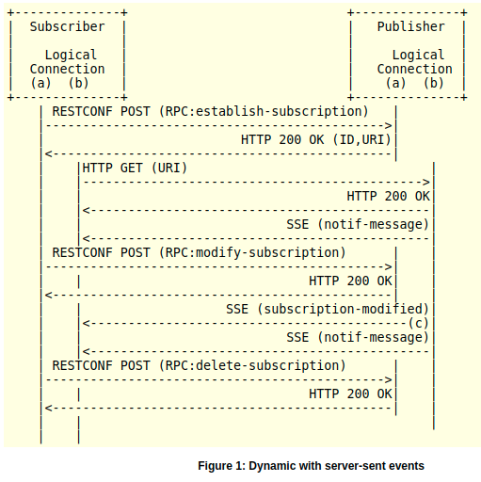
Notification
Subscribing to event streams is accomplished in this way via a RESTCONF POST into RPCs .
A GET needs to be made against a specific URI on the publisher.
Subscribers cannot pre-determine the URI against which a subscription might exist on a publisher, as the URI will only exist after the "establish-subscription" RPC has been accepted.
The subscription URI will be determined and sent as part of the response to the "establish-subscription" RPC, and a subsequent GET to this URI will be done in order to start the flow of notification messages back to the subscriber.

Slide 20
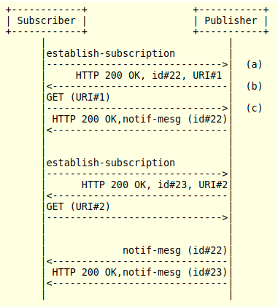
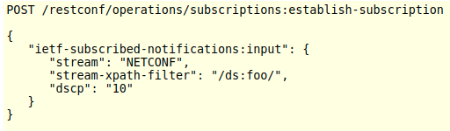
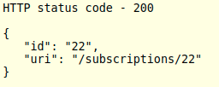

Notification example
establish-subscription request (a)
establish-subscription success (b)
Multiple subscriptions over RESTCONF/HTTP
figure shows two successful "establish-subscription" RPC requests. The first request is given a subscription identifier of 22, the second, an identifier of 23
Subscribing to receive notifications (c)

Slide 21
Query Parameters
Each RESTCONF operation allows zero or more query parameters to be present in the request URI
Query parameters can be given in any order
Each parameter can appear at most once in a request URI
A default value may apply if the parameter is missing
Query parameter names and values are case sensitive
Name | Methods | Description
content | GET, HEAD | Select config and/or non-config data resources
depth | GET, HEAD | Request limited subtree depth in the reply content
fields | GET, HEAD | Request a subset of the target resource contents
filter | GET, HEAD | Boolean notification filter for event stream resources
insert | POST, PUT | Insertion mode for "ordered-by user" data resources
point | POST, PUT | Insertion point for "ordered-by user" data resources
start-time | GET, HEAD | Replay buffer start time for event stream resources
stop-time | GET, HEAD | Replay buffer stop time for event stream resources
with-defaults | GET, HEAD | Control the retrieval of default values

Slide 22
Content
Example: To retrieve only the configuration child resources, the "content" parameter is set to "config".
GET /restconf/data/example-events:events?content=config
Host: example.com
Accept: application/yang-data+json
The server might respond as follows:
HTTP/1.1 200 OK
Date: Thu, 26 Jan 2017 20:56:30 GMT
Server: example-server
Last-Modified: Thu, 26 Jan 2017 16:45:20 GMT
ETag: "eeeada438af"
Cache-Control: no-cache
Content-Type: application/yang-data+json
{
"example-events:events":{
"event":[
{
"name":"interface-up",
"description":"Interface up notification count"
},
{
"name":"interface-down",
"description":"Interface down notification count"
}
]
}
}
The "content" query parameter controls how descendant nodes of the requested data nodes will be processed in the reply.
The allowed values are:
Config - Return only configuration descendant data nodes
Non Config - Return only non-configuration descendant data nodes
All - Return all descendant data nodes
This parameter is only allowed for GET methods on datastore.
If this query parameter is not present, the default value is "all".
This query parameter MUST be supported by the server.

Slide 23
depth
To limit the depth level to the target resource plus two child resource layers, the value "3" is used.
GET /restconf/data/example-jukebox:jukebox?depth=3
Host: example.com
Accept: application/yang-data+json
The server might respond as follows:
HTTP/1.1 200 OK
Date: Thu, 26 Jan 2017 20:56:30 GMT
Server: example-server
Cache-Control: no-cache
Content-Type: application/yang-data+json
{
"example-jukebox:jukebox":{
"library":{
"artist":{
}
},
"playlist":[
{
"name":"Foo-One",
"description":"example playlist 1",
"song":{
}
}
],
"player":{
"gap":0.5
}
}
}
The "depth" parameter is used to limit the number of levels of child resources that are returned by the server for a GET method request.
The "depth" parameter starts counting levels at the level of the target resource that is specified, so that a depth level of "1" includes just the target resource level itself.
A depth level of "2" includes the target resource level and its child nodes.

Slide 24
fields
The "fields" query parameter is used to optionally identify data nodes within the target resource to be retrieved in a GET method.
The client can use this parameter to retrieve a subset of all nodes in a resource.
The server will return a message-body representing the target resource, with descendant nodes pruned as specified in the "fields-expr" value. The server does not return a set of separate sub-resources.
A value of the "fields" query parameter matches the following rule:
fields-expr = path "(" fields-expr ")" / path ";" fields-expr / path
path = api-identifier [ "/" path ]
";" is used to select multiple nodes. For example, to retrieve only the "genre" and "year" of an album, use "fields=genre;year".
Parentheses are used to specify sub-selectors of a node. Note that there is no path separator character "/" between a "path" field and a left parenthesis character "(". For example, assume that the target resource is the "album" list. retrieve only the "label" and "catalogue-number" of the "admin" container within an album, use
"fields=admin(label;catalogue-number)".
"/" is used in a path to retrieve a child node of a node. example, to retrieve only the "label" of an album, use "fields=admin/label".
GET /restconf/data?fields=ietf-yang-library:modules-state/module(name;revision)
Host: example.com
Accept: application/yang-data+json
The server might respond as follows:
HTTP/1.1 200 OK
Date: Thu, 26 Jan 2017 20:56:30 GMT
Server: example-server
Content-Type: application/yang-data+json
{
"ietf-restconf:data":{
"ietf-yang-library:modules-state":{
"module":[
{
"name":"example-jukebox",
"revision":"2016-08-15"
},
{
"name":"ietf-inet-types",
"revision":"2013-07-15"
},
{
"name":"ietf-restconf-monitoring",
"revision":"2017-01-26"
},
{
"name":"ietf-yang-library",
"revision":"2016-06-21"
},
{
"name":"ietf-yang-types",
"revision":"2013-07-15"
}
]
}
}
}

Slide 25
insert
The "insert" query parameter is used to specify how a resource should be inserted within an "ordered-by user" list.
The allowed values are:
First - Insert the new data as the new first entry.
Last - Insert the new data as the new last entry.
Before - Insert the new data before the insertion point, as specified by the value of the "point" parameter.
After - Insert the new data after the insertion point, as specified by the value of the "point" parameter.
The default value is "last".
This parameter is only supported for the POST and PUT methods.
It is also only supported if the target resource is a data resource, and that data represents a YANG list or leaf-list that is "ordered-by user".
In this example, a new first song entry in the "Foo-One" playlist is being created.
Request from client:
POST /restconf/data/example-jukebox:jukebox/playlist=Foo-One?insert=first
Host: example.com
Content-Type: application/yang-data+json
{
"example-jukebox:song":[
{
"index":1,
"id":"/example-jukebox:jukebox/library/artist[name=’Foo Fighters’]/album[name=’Wasting Light’]/song[name=’Rope’]"
}
]
}
Response from server:
HTTP/1.1 201 Created
Date: Thu, 26 Jan 2017 20:56:30 GMT
Server: example-server
Last-Modified: Thu, 26 Jan 2017 20:56:30 GMT
Location: https://example.com/restconf/data/\
example-jukebox:jukebox/playlist=Foo-One/song=1
ETag: "eeeada438af"

Slide 26
point
In this example, the client is inserting a new song entry in the "Foo-One" playlist after the first song.
Request from client:
POST /restconf/data/example-jukebox:jukebox/playlist=Foo-One?insert=after&point=\%2Fexample-jukebox%3Ajukebox\%2Fplaylist%3DFoo-One%2Fsong%3D1
Host: example.com
Content-Type: application/yang-data+json
{
"example-jukebox:song":[
{
"index":2,
"id":"/example-jukebox:jukebox/library
/artist[name=’Foo Fighters’]\\
/album[name=’Wasting Light’]\\
/song[name=’Bridge Burning’]"
}
]
}
Response from server:
HTTP/1.1 201 Created
Date: Thu, 26 Jan 2017 20:56:30 GMT
Server: example-server
Last-Modified: Thu, 26 Jan 2017 20:56:30 GMT
Location: https://example.com/restconf/data/\
example-jukebox:jukebox/playlist=Foo-One/song=2
ETag: "abcada438af"
The "point" query parameter is used to specify the insertion point for a data resource that is being created or moved within an "ordered-by user" list or leaf-list.
The value of the "point" parameter is a string that identifies the path to the insertion point object.
The format is the same as a target resource URI string.
This parameter is only supported for the POST and PUT methods.
It is also only supported if the target resource is a data resource, and that data represents a YANG list or leaf-list that is
"ordered-by user".

Slide 27
References
https://www.routerfreak.com/using-restconf-for-network-automation/
https://standards.incits.org/apps/group_public/download.php/90692/T11-2017-00027-v002.pdf
https://devnetdan.com/2020/09/27/netconf-vs-restconf/
https://blogs.cisco.com/developer/johann02
https://forum.huawei.com/enterprise/en/netconf-restconf-and-yang/thread/834865-861
https://developer.cisco.com/video/net-prog-basics/
https://standards.incits.org/apps/group_public/download.php/90692/T11-2017-00027-v002.pdf
https://forum.huawei.com/enterprise/en/difference-between-the-restconf-and-netconf/thread/617982-861
http://www.watersprings.org/pub/id/draft-ietf-netconf-restconf-notif-08.html
https://www.youtube.com/watch?v=cooE3wZ7O4I
https://datatracker.ietf.org/doc/html/rfc8072
https://datatracker.ietf.org/doc/html/rfc8040

Slide 28
Thank you

